Slide 1
CTG ASSIGNMENT
GROUP 4
By: Edward, Che Peng, Daniel, Minn

Slide 2
RC4
Byte-Oriented Stream Cipher
Invented by Ron Rivest in 1987
Is widely used in protocols such as Wired Equivalent Privacy (WEP) and Remote Desktop Protocol
Encrypts plaintext one byte at a time using a key stream
Notes:
Rivest Cipher 4 also known as RC4 is a byte-oriented stream cipher that is invented by Ron Rivest in 1987. It is the most widely adopted stream cipher and used in various protocols such as Wired Equivalent Privacy and Remote Desktop Protocol. The algorithm encrypts plaintext one byte at a time using a key stream. We will talk about the key stream in the next slide.

Slide 3
KEY STREAM
RC4
Independent of the Plain Text
A variable key length of 1 to 256 bytes is used to initialize a 256-byte state vector S through a process called KSA
A pseudo-random stream is then generated through a process called PRGA, where every values of S is swapped.
Notes:
For the key stream generation, it is independent of the plain text and consists of two main components; key Scheduling Algorithm (KSA) and Pseudo Random Number Generation (PRGA). Through KSA, a variable key length of 1 to 256 bytes is used to initialize a 256-byte state vector S. PRGA generates a pseudo-random stream, where every values of vector S is swapped.

Slide 4
RC4
KEY STREAM CODE
KSA Initialisation: for PRGA:
i = 0 to 255 do S[i] = i; I, j T[i] = K[i mod k - len]; while(true)
KSA Permutation: I t = (S[i] + S[j])mod 256;
j = 0; i = (i + 1)mod 256; k = S[t]; j = (j + S[i])mod 256;
for j = 0; Swap(S[i], S[j]);
i = 0 to 255 do t = (S[i] + S[j])mod 256;
{ k = S[t];
j = (j + S[i] + T[i])mod 256;
Swap(S[i], S[j]);
Notes:
This is the code for the key stream process.
The first step is to initialize state vector S and temporary vector T, both with a length of 256-bytes. To initialize S, each element of S is assigned a value from 0 to 255 in ascending order: S[i] = i, S[0] = 0 to S[255] = 255. As for the initialization of T, the elements from key K are copied to T (in the same order) and the process repeats itself until it is fully filled.
The second step is to produce the initial permutation of S. Starting from the first (0) to last (255) element of S, each byte at S[i] is swapped with another byte S[j] in S according to the arrangement of T.
Moving on, the third step is to generate the key stream. Using array S from the output of KSA in step two, each byte at S[i] is swapped with another byte in S according to the current arrangement of S. Every value of S is swapped from S[0] to S[255] and restarts again from S[0] until the required key stream length is reached.

Slide 5
ENCRYPTION / DECRYPTION
RC4
The key stream generated by PRGA is XORed with each byte of plaintext to produce the cipher text
X-ORed Operation:
for l in range(plaintext):
ciphertext.append(k ^ plaintext[l])
Notes:
For the Encryption process, the final key stream generated by PRGA is XORed with each byte of the plaintext to produce the cipher text. The Decryption process is roughly the same, where the encrypted PlainText is Xored with the same key stream to produce the decrypted result. Here is an example on how the Plain Text can be Xored

Slide 6
RC4
STRENGTHS
WEAKNESSES
Easy to Implement
Fast speed of Operations
Can encrypt large stream of data
Vulnerable to a stream cipher and analytic attack if not implemented correctly
Cannot implement on small streams of data
Does not provide authentication
Notes:
For the strengths of RC4, it is easy to implement as there are not complicated mathematical formulas. It has a faster speed of operation compared to other operations as it does not perform complicated mathematical operations and is used on large streams of data.
The RC4 algorithm is vulnerable to a stream cipher and analytic attack if it is not implemented correctly, it also cannot be implemented on small streams of data and does not provide authentication.

Slide 7
EL-GAMAL
Taher Elgamal in 1985
Based on the Diffie-Hellman key exchange
Apps like GNU Privacy Guard, PGP, digital signatures
Key Generation, Encryption, Decryption
Notes:
ElGamal cryptosystem is an a-symmetrical cryptosystem that was first described by Taher Elgamal in 1985. It is based on the Diffie-Hellman key exchange and used in applications such as the free GNU Privacy Guard and recent versions of Pretty Good Privacy, and also in digital signatures. It consists of 3 components - key generation, encryption, and decryption.

Slide 8
KEY GENERATION
EL-GAMAL
Public key = (G,q,g,h)
q - A large prime number is generated
G - The cyclic group of q
g - A random value in the G
h = g**x
Private key = (x)
x = A random number in the G
Notes:
For the key generation process, since it is an a-symmetric cryptosystem, it requires a public and private key. The public key has 4 variables, (G,q,g,h), where q is a large random prime number that is generated, G is the cyclic group of q, g is a random number in the cyclic group and h is computed as g**x
The private key of El Gamal has a variable x, and it must be a random number that is in the cyclic Group, G

Slide 9
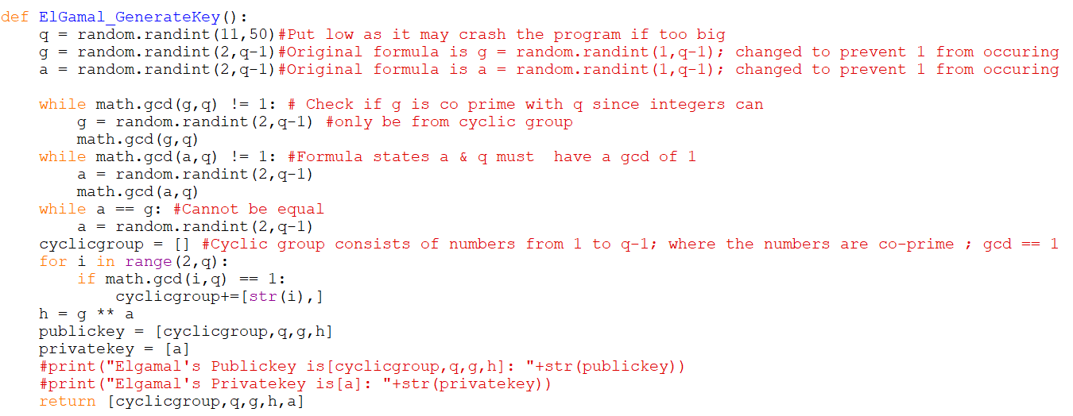
Code For Key Generation
EL-GAMAL
Notes:
This is the code we had created for the generation of keys of ElGamal.

Slide 10
Encryption
EL-GAMAL
K is chosen at random and must be in the cyclic group
p is calculated from p = g ** k
S is calculated from s = h ** k
Encrypted values are sent as a pair (p,s*M)
Notes:
Moving on to the encryption process, a random variable k is chosen and this value of k must be in the cyclic group G, variable p is then calculated using public key variable g, to the power of k. The variable S is then calculated from public key value,h to the power of k. Encrypted values are sent in pairs(p, s*M)

Slide 11
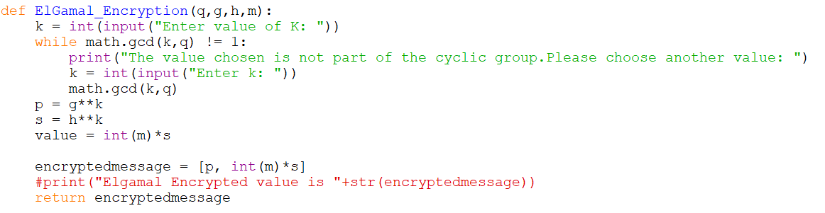
Code For ElGamal Encryption
EL-GAMAL
Notes:
This is an example of the code we created for the encryption process of ElGamal

Slide 12
Decryption
EL-GAMAL
Formula for decryption process - M = (s*M / p ** x)
s can be simplified from s = h ** k to s = (g**x)**k
p ** x can be simplified to (g ** k) ** x
Since (g**x)**k is always equal to (g ** k) ** x
Plain Text can be found through simple division
Notes:
For the Decryption Process, Plain Text Message can be found through the equation (s*M / p**x). Since s can be simplified to h **k and to g**x **k and p**x can be simplified to g**k **x, Plain Text can be found by simply found by simple division due to the fact g**x**k is always the same as g**k**x.

Slide 13

Code For ElGamal Decryption
EL-GAMAL
Notes:
this is the code for decryption

Slide 14
EL-GAMAL
STRENGTHS
WEAKNESSES
Probabilistic encryption
Different cipher text will be produced
Keys with discrete logarithm using cyclic groups
Slower speed
Malleable
Notes:
ElGamal has probabilistic encryption since a random k is chosen every time, so a different ciphertext will be generated each time using the same plaintext. It also generates the keys with discrete logarithm using cyclic groups.
however, it has a slower speed due to the need for randomness and requires more resources for the long ciphertext it generates and to perform extensive computations for the massive logarithmic calculations. It is also unconditionally malleable which makes it insecure under a chosen ciphertext attack.

Slide 15
Paillier
Was invented and named after Pascal Pilliar in 1999
Probabilistic asymmetric algorithm based on Decisional Composite Residuosity Assumption.
Has Homomorphic features such as Homomorphic Addition and Homomorphic Multiplication
Has 3 parts, Key generation, Encryption, Decryption

Slide 16
Homomorphic Features
PAILLIER
Homomorphic Addition
The product of two encrypted ciphertext decrypted into the sum of the corresponding plaintext
D(C1 * C2 mod n**2) = PT1 + PT2 mod n
Homomorphic Multiplication
An encrypted plaintext raised to the power of another plaintext decrypts into the product of the two plaintexts
D(C1**m2 mod n**2) = PT1 * PT2 mod n

Slide 17
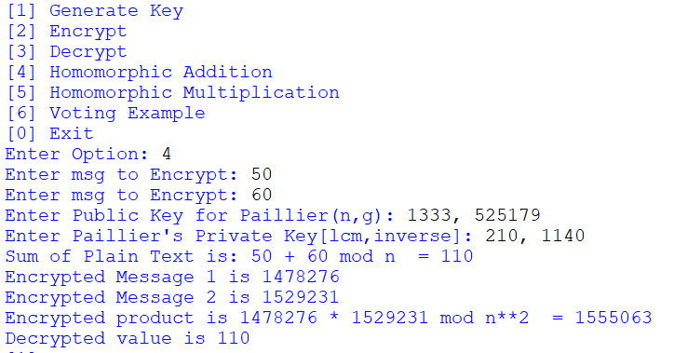
Example on Homomorphic Addition
PAILLIER

Slide 18
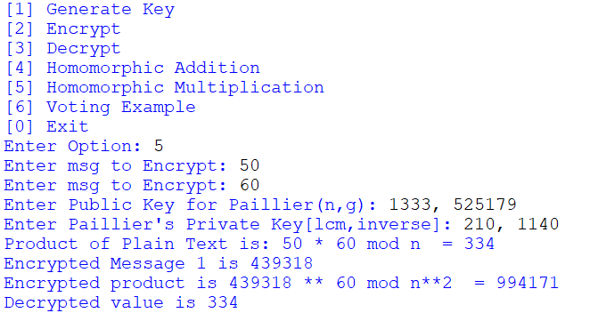
Example on Homomorphic Multiplication
PAILLIER

Slide 19
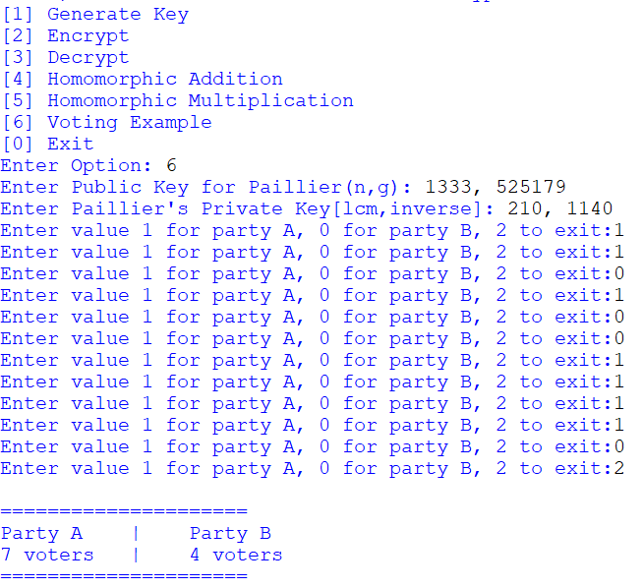
Example on Voting System
PAILLIER

Slide 20
Key Generation
PAILLIER
Public key (n,g)
n is the product of two random large prime numbers, p and q.
g is a random value in the cyclic group of n**2, ie gcd(g,n**2) == 1
Private key (lcm,mmi)
Lcm is the lowest common multiple of the two random large prime numbers, where both numbers are deducted by one, (p-1,q-1)
mmi is the modular multiplicative inverse of ((((g**lcm) mod n**2) -1 ) // n) **-1 mod n

Slide 21
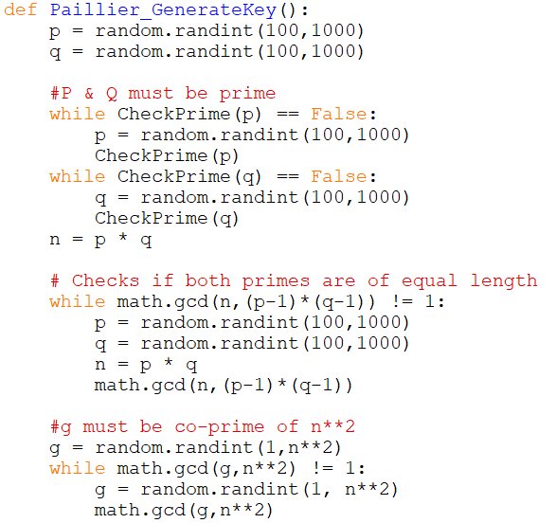
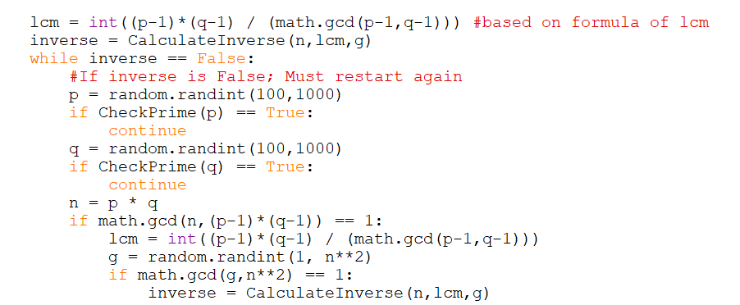
PAILLIER
Public
Private
Code for Generation of Keys
Notes:
For the strengths of RC4, it is easy to implement as there are not complicated mathematical formulas. It has a faster speed of operation compared to other operations as it does not perform complicated mathematical operations.

Slide 22
Encryption
PAILLIER
Uses Only the Public Key
Plain Text must be > 0 and < n
Variable r is randomly chosen and must be in the cyclic group of n
Cipher text is computed through the formula:
CT = (g**PT) * ((r)**n) mod n**2

Slide 23
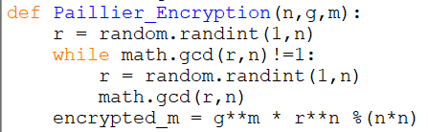
Code for Paillier Encryption
PAILLIER

Slide 24
Decryption
PAILLIER
Uses both Public and Private keys
The cipher text must be in cyclic group of n**2
Decryption Formula:
(((CT)**lcm mod n**2) -1) // n * mmi mod n

Slide 25
Code for Decryption
PAILLIER

Slide 26
Strengths / Weaknesses
PAILLIER
Strengths:
Believed to be intractable due to Decisional Composite Residuosity Assumption.
Provides semantic security against chosen plain-text attacks
Weaknesses:
Malleable and does not provide best semantic security
Slow in the encrypting and decrypting process when large numbers are used

Slide 27
EXP
Uses 2 rounds of encryption, using two a-symmetrical cryptosystems
First encrypts a text of letters using Paillier cryptosystem.
Encrypted values are then encrypted again through El Gamal cryptosystem.

Slide 28
Key Generation
EXP
Public Key of EXP is the Paillier Public Key being appended to the ElGamal Public Key, likewise for the private key.
Public key: (G,q,g,h,n,pg), where G,q,g,h is the public key in ElGamal,and n,g is the public key in Paillier.
Private key: (x,lcm,mmi), where x is the private key in ElGamal, lcm and mmi are the private keys in Paillier.

Slide 29
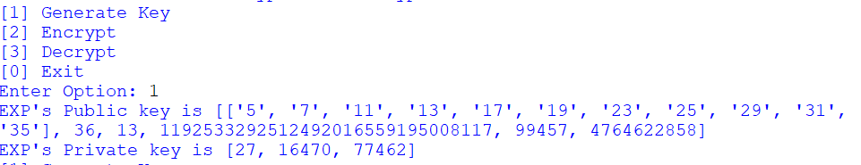
Example of Output for Key Generation
EXP

Slide 30
Encryption
EXP
Uses Public Key
Plain Text inputted as a string
The plan text will then be encrypted by the Paillier cryptosystem
These encrypted text will then be encrypted by the El Gamal cryptosystem
Notes:
For the encryption process of EXP, it requires the values in the Public Key. The Public Key values will be inputted by the user, and for user’s convenience, does not need to include the cyclic group. User then keys in the Plain Text message that is going to be encrypted. The message will be converted to numbers, and then, letter by letter, will be encrypted using Paillier cryptosystem. Each encrypted value will then go through a second round of encryption using El Gamal.

Slide 31
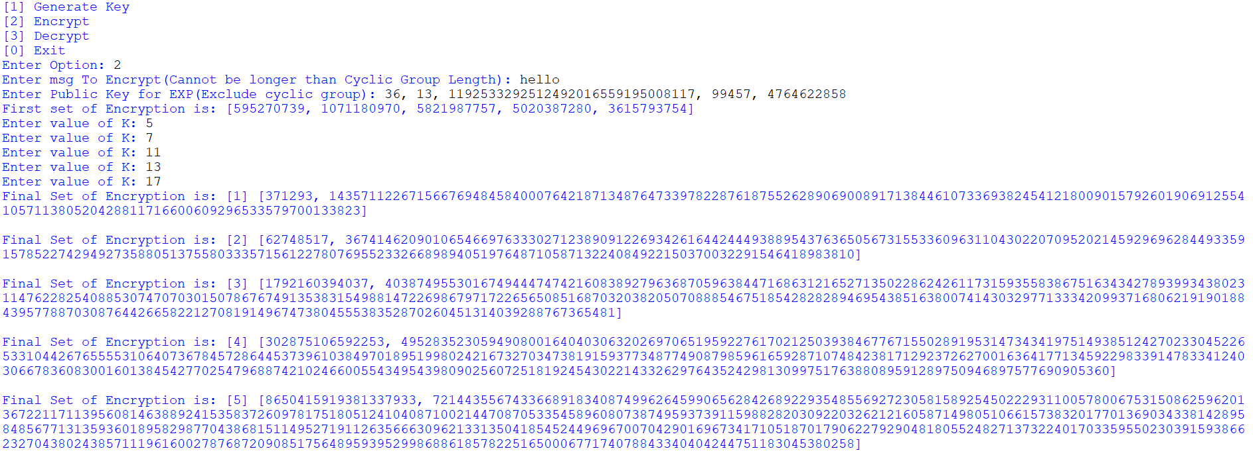
Example of Code Output
EXP

Slide 32
Decryption
EXP
Uses Both Public key and Private key
Users need to specify the number of encrypted values
And need to key in each set of encrypted values one at a time into the program.
The program then decrypts the first set of values through ElGamal decryption
The decrypted values are then further decrypted through Paillier to get the plain text.
Notes:
For the Decryption Process,

Slide 33
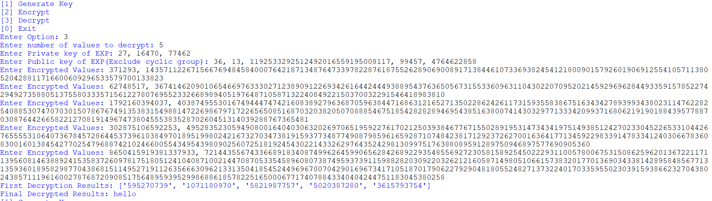
Example of Output for Decryption
EXP

Slide 34
EXP
STRENGTHS
WEAKNESSES
Allows for multiple values of K used, making the process more random
Two rounds of encryption, making it more secure
Can be used in a hybrid cryptosystem for securely transporting secret keys when symmetric ciphers are used.
Encryption and Decryption process can be very slow
Only messages in alphabets can be encrypted
Notes:
For the strengths of RC4, it is easy to implement as there are not complicated mathematical formulas. It has a faster speed of operation compared to other operations as it does not perform complicated mathematical operations.

Slide 35
Conclusion
The three cryptosystems we have researched on are the RC4 stream cipher, ElGamal Encryption, and Paillier Encryption – Although not used commonly nowadays with their weaknesses and other algorithms.
They have their own strengths and can be used in other cryptosystems, maximising their strengths.

